Slide 1

APIGEE - API Management Platform - (Introduction, Basic Concepts, KVM, Caching, Flows, Debugging, Security)
Java Full Stack Program

Slide 2
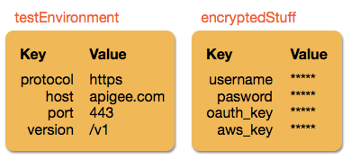
KVM
There are times when you want to store data for retrieval at runtime—non-expiring data that shouldn't be hard-coded in your API proxy logic. Key value maps (KVMs) are ideal for this. A KVM is a custom collection of key/value String pairs that is either encrypted or unencrypted. Here are two examples:
Java Full Stack Program

Slide 3
KVM scenarios
Here are some situations where KVMs come in handy:
You have an API proxy that needs to call one target (or Service Callout) URL in a test environment and another target URL in a production environment. Instead of hard-coding URLs in your proxy, you can have the proxy detect which environment it's in, execute the related Key Value Map Operations policy, and retrieve the correct target URL from one of the KVMs you created. And later, if one or both of your targets change, you simply update the KVMs with the new URLs. The proxy picks up the new values, and no proxy redeployment is required.
You want to store credentials, private keys, or tokens—like tokens for external services, credentials required to generate OAuth tokens, or private keys used in Java Callouts or JavaScript for encryption or JSON Web Token (JWT) signing. Instead of passing credentials, keys, or tokens in the request, or hard-coding them in your proxy logic, you can store them in a KVM (always encrypted) and dynamically retrieve them in calls to targets that require them.
Java Full Stack Program

Slide 4
You'll discover other situations where storage of key/value String pairs
is useful. In general, consider using KVMs when:
Specific places in your code require different values at runtime.
Sensitive data needs to be passed without hard-coding it.
You want to store values that don't expire like a cache might.
KVMs have scope
Scope means "where a KVM is available." KVMs can be created at the following scopes: organization, environment, and apiproxy.
For example, if only one API proxy requires data in a KVM, you can create the KVM at the apiproxy scope, where only that API proxy can access the data.
Or you may want all API proxies in your test environment to have access to a key value map, in which case you'd create a key value map at the environment scope.
Java Full Stack Program

Slide 5
Proxies deployed in the "prod" environment cannot access KVMs in the "test" environment scope. If you want the same KVM keys to be available in production, create a parallel KVM scoped to the "prod" environment.
If you want all proxies in all environments to access the same KVM, create the KVM at the organization scope.
About encrypted KVMs
Encrypted KVMs are encrypted with an Apigee-generated AES-128 cipher key. The key used to encrypt a KVM is stored at the scope of the KVM. For example, within an organization, all encrypted KVMs you create at the environment scope are created using the same environment-scoped key.
Edge handles the display of encrypted values in the following ways. (See Managing and using KVMs for information on creating encrypted KVMs.)
Java Full Stack Program

Slide 6
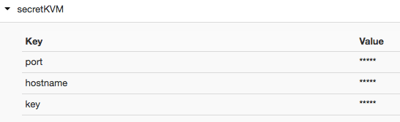
Edge UI
Encrypted key value maps display values masked with asterisks in the UI (*****). For example:
Java Full Stack Program

Slide 7
Management API
In the management API, encrypted values are returned masked. Following is sample management API response on a Get encrypted KVM call:
{
"encrypted": true,
"entry": [
{
"name": "Key1",
"value": "*****"
},
{
"name": "Key2",
"value": "*****"
}
],
"name": "secretMap"
}
Java Full Stack Program

Slide 8

Trace and debug
When you use the Key Value Map Operations policy to retrieve encrypted KVM values, you supply the name of a variable to store the value. To get an encrypted value, you need to add the "private." prefix to the variable name, which prevents the KVM keys/values from appearing in Trace and debug sessions.
Java Full Stack Program

Slide 9
Limits
In organizations with Core Persistence Services (CPS) enabled:
The KVM name/identifier is case sensitive.
Key size is limited to 2 KB.
Value size is limited to 10 KB.
For Apigee Edge for Private Cloud, each KVM should not exceed 15MB (this is the combined size of the keys and values). If you exceed this limit, Apigee Edge for Private Cloud returns an error. To determine the size of your KVMs, you can use the nodetool cfstats command.
Larger KVMs can result in performance degradation. As a result, you should split large, monolithic KVMs into smaller ones to improve performance.
Java Full Stack Program

Slide 10
Managing and using KVMs
You can create, manage, and use KVMs in a variety of ways. This section describes different options for creating, then retrieving, both encrypted and unencrypted KVMs.
Creating and updating KVMs
You can create and update KVMs in the following ways:
Key Value Map Operations policy (no encryption)
For runtime KVM creation and update by your API proxies, use the Key Value Map Operations policy. (In the policy, you specify the name of the KVM in the mapIdentifier attribute on the parent element.)
Java Full Stack Program

Slide 11
The <InitialEntries> element lets you create and populate a baseline set of entries in a new KVM as soon as you save the policy in the UI or deploy the API proxy (if you developed it offline). If the values change in the policy, the existing values are overwritten. Any new keys/values are added to the existing KVM alongside the existing keys/values.
The <Put> element creates a new KVM if one doesn't already exist, and it creates a key with one or more values. If the KVM already exists, they key/values are added (or updated if the key already exists). You can use multiple <Put> elements in a KVM policy.
Java Full Stack Program

Slide 12
Management API
The management API is for working with KVMs as an administrator rather than during runtime in your API proxies. For example, you may have an internal script that uses the management API to delete and recreate KVMs in a test environment, or you may want to reset a key's value in a KVM for all proxies to pick up. (For runtime manipulation of KVMs, use the Key Value Map Operations policy in your proxies).
The Key/Value Maps management API lets you create, update, and delete encrypted KVMs and keys/values at all scopes (organization, environment, and apiproxy).
To create an encrypted KVM with the management API, add "encrypted" : "true" to the JSON payload. You can only encrypt KVMs when you create them. You cannot encrypt an existing KVM.
Java Full Stack Program

Slide 13
Management UI
In the Edge management UI, you can create and update environment-scoped KVMs, which are the only scope of KVM that appears in the UI. The management UI is a good way to manually administer KVM data for API proxies at runtime. See Creating and editing environment key value maps for more information.
Retrieving KVMs
You retrieve encrypted and unencrypted key value maps the same way, with one slight variation when retrieving with the Key Value Map Operations policy.
Java Full Stack Program

Slide 14
Retrieving KVMs
Policy: Use the <Get> element in the Key Value Map Operations policy to retrieve encrypted and unencrypted KVMs. The one slight difference is retrieving encrypted values with the policy, where you must add a "private." prefix to the name of the variable that will contain the retrieved value, as described in the Get operation section of the reference topic. That prefix hides the value from Trace and debug sessions while you're debugging API proxies.
Management API: For administrative management purposes, you can use the Creating and editing environment key value maps to get KVMs and keys/values. For example, if you want to back up KVMs by getting and storing the JSON definitions, use the management API. Be aware, though, that encrypted values are displayed as ***** in the API response.
Management UI: You can view your environment-scoped KVMs in the management UI by going to APIs > Environment Configuration > Key Value Maps (Classic Edge) or Admin > Environments > Key Value Maps
Java Full Stack Program

Slide 15
Adding caching
Using policies for general purpose caching, you can persist any objects your proxy requires across multiple request/response sessions. You can also cache backend response data.
You might want to use a cache to:
Reduce latency and traffic. Requests are satisfied in a shorter time and with reused representations.
Persist data across transactions. You can store session data for reuse across HTTP transactions.
Support security. Scope access to cache entries so they can be accessed only in a particular environment or by a specific API proxy.
Java Full Stack Program

Slide 16
Backend response caching
You can cache the response of a backend resource with the ResponseCache policy.
This is especially helpful when backend data is updated only periodically. The ResponseCache policy can reduce calls to backend data sources.
Through the ResponseCache policy, you can also have Apigee look at certain HTTP response caching headers and take actions according to header directives. For example, on responses from backend targets, Apigee supports the Cache-Control header. This header can be used to control the maximum age of a cached response, among other things. For more information, see Support for HTTP response headers.
Java Full Stack Program

Slide 17
Short-term general purpose caching
Using policies for general purpose caching, you can persist any objects your proxy requires across multiple request/response sessions.
With the PopulateCache policy, LookupCache policy, and InvalidateCache policy, you can populate, retrieve, and flush cached data at runtime.
For example, you might temporarily store:
Session IDs for session management.
Credentials for outbound calls (such as API keys or OAuth access tokens).
Response content that must be paginated for apps.
At runtime, your cache policies copy values between proxy variables and the configured cache you specify. When a value is placed in the cache, it is copied from the variable you specify to the cache. When it is retrieved from the cache, it is copied into the variable for use by your proxy.
Java Full Stack Program

Slide 18
Long-term persistence with key value maps (KVMs)
To indefinitely store structured data either encrypted or unencrypted, you can create and populate key value maps (KVMs) that contain arbitrary key/value pairs. For example, you might store:
A map correlating IP addresses to country codes.
A list of IP addresses that are allowed/denied access.
A map correlating long URLs to shortened URLs.
Environment-specific data, such as quota counts and OAuth token expiration times.
KVMs can have one of three scopes: organization, environment, apiproxy. For example, if key/value pairs are to be used for all APIs in an organization, create a KVM at the organization scope; or if only a specific API proxy should have access to keys/values, create the KVM at the apiproxy scope. For more information, see Working with key value maps.
Java Full Stack Program

Slide 19
Property sets
A property set is a custom collection of key/value pairs that store data. API proxies can retrieve this data when they execute.
Typically, you use property sets to store non-expiring data that shouldn't be hard-coded in your API proxy logic, such as configuration data. You can access property set data anywhere in a proxy where you can access flow variables.
A common use case for property sets is to provide values that are associated with one environment or another. For example, you can create an environment-scoped property set with configuration values that are specific to proxies running in your test environment, and another set for your production environment.
Java Full Stack Program

Slide 20
Controlling how a proxy executes with flows
Any application programming model includes a way to control the flow of processing. In an API proxy, that's done with flows. To flows you add logic, condition statements, error handling, and so on. You use flows to control what happens, and when.
Flows are sequential stages along the API request processing path. When you add proxy logic, such as to verify an API key, you add the logic as a step in the sequence specified by a flow. When you define a condition to specify whether and when logic executes, you add the condition to a flow.
The following flow configuration example defines a flow in which the VerifyAPIKey policy executes if the incoming request path ends with / and the request's HTTP verb is GET.
Java Full Stack Program

Slide 21
<Flow name="Get Food Carts">
<Description>Get Food Carts</Description>
<Request>
<Step>
<Name>Verify-API-Key</Name>
</Step>
</Request>
<Condition>(proxy.pathsuffix MatchesPath "/") and (request.verb = "GET")</Condition>
</Flow>
Java Full Stack Program

Slide 22
Designing flow execution sequence
You structure flows so that you can have logic execute in the right sequence along the processing path.
When deciding where to add logic, you'll first choose whether to add it to a proxy endpoint or target endpoint. An API proxy divides its code between code that interacts with the proxy's client (proxy endpoint) and optional code that interacts with the proxy's backend target, if any (target endpoint).
Java Full Stack Program

Slide 23
Both endpoints contain flows, as described here:
Endpoint type | Description | Flows supported
ProxyEndpoint | Contains the API proxy flows closest to the client. Provides places for logic to act first on the request from the client, then last on the response to the client. | PreFlow, conditional flows, PostFlow, PostClientFlow
TargetEndpoint | Contains the API proxy flows closest to the backend resource. Provides places for logic to prepare a request for, then handle the response from, a backend resource. | PreFlow, conditional flows, PostFlow
Java Full Stack Program

Slide 24
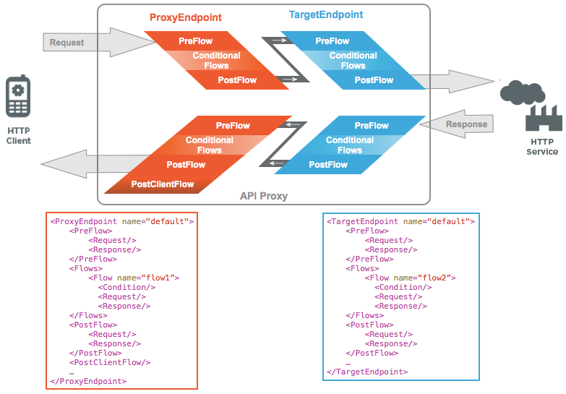
You configure flow with XML that specifies what should happen and in what order. The following illustration shows how flows are ordered sequentially within a proxy endpoint and target endpoint:
Java Full Stack Program

Slide 25
Debugging an extension
You can debug an extension by using messages visible in two places: the Trace tool and extension logs. When an extension isn't working, identifying the problem can sometimes require information from both places.
The Apigee Edge Trace tool is where you iteratively test and edit API proxy code as you develop it. Trace messages include errors from your API proxy code, including API proxy and policy configuration.
Extension-related errors that appear in the Trace tool don't usually contain much detail, except to say which extension callout failed, along with an HTTP error code. When you don't see anything useful here, the next best place to look is the log for the extension you're using.
Extensions generate log entries at runtime. (Extension logs are available for organization administrators only.)
Java Full Stack Program

Slide 26
These logs include entries returned by the external resource the extension is configured to interact with. For example, if external resource credentials are misconfigured in the extension, the error is likely to appear here.
The logs also include entries from internal extension code. When you're looking through the logs, keep in mind that some of the entries aren't relevant to the error you're correcting.
Error types and causes
This is the configuration that an organization administrator does when adding an extension to an environment.
For example, if you configure the Cloud Logging extension with an incorrect Google Cloud project ID, Google Cloud Logging will return an error to the extension. Details about these errors are usually in the extension log.
Java Full Stack Program

Slide 27
Introduction to security reporting
As more and more business-critical applications are exposed via APIs, operations teams need visibility into security attributes of APIs to:
Ensure adherence to security policies and configuration requirements.
Protect sensitive data from internal and external abuse.
Proactively identify, diagnose, and resolve security incidents.
About security reporting
Security reporting provides in-depth insights for operations teams to ensure adherence to policies and configuration requirements, protect APIs from internal and external abuse, and quickly identify and resolve security incidents.
Java Full Stack Program

Slide 28
With security reporting, you can quickly understand how your API proxies are configured for security, as well as the runtime conditions that might impact proxy security. Using this information, you can adjust the configuration to ensure you have the appropriate level of security for each proxy.
Security reporting also helps you protect sensitive data by providing insights into user access and behavior, letting you monitor who in your organization is accessing and exporting sensitive information, and identifying suspicious behavior.
Java Full Stack Program

Slide 29
Versions of security reporting
All Edge for Cloud Enterprise customers have access to the basic set of security reporting features available in the Edge UI. The data for these reports is also available to Enterprise customers by using the security reporting APIs.
Edge for Cloud customers without an Enterprise account cannot access security reporting. For more information on Edge pricing plans.
Java Full Stack Program

Slide 30
THANK YOU
Java Full Stack Program

